Slide 1
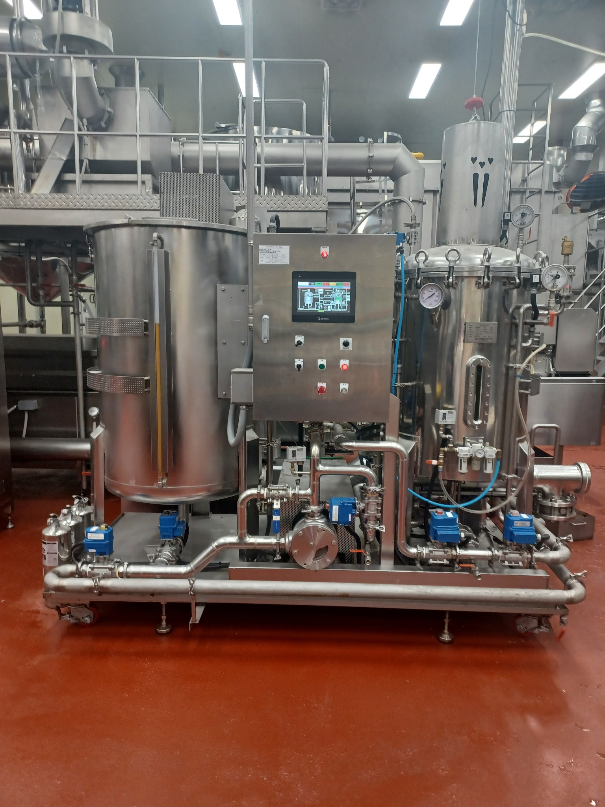
DD AUTOMATIC
LIQUID FILTRATION
SYSTEM
One-touch automation for efficient filtration,
sludge discharge and rapid cleaning.
FILTECH KOREA SYSTEM
Built for real production environments
KOREA

Slide 2
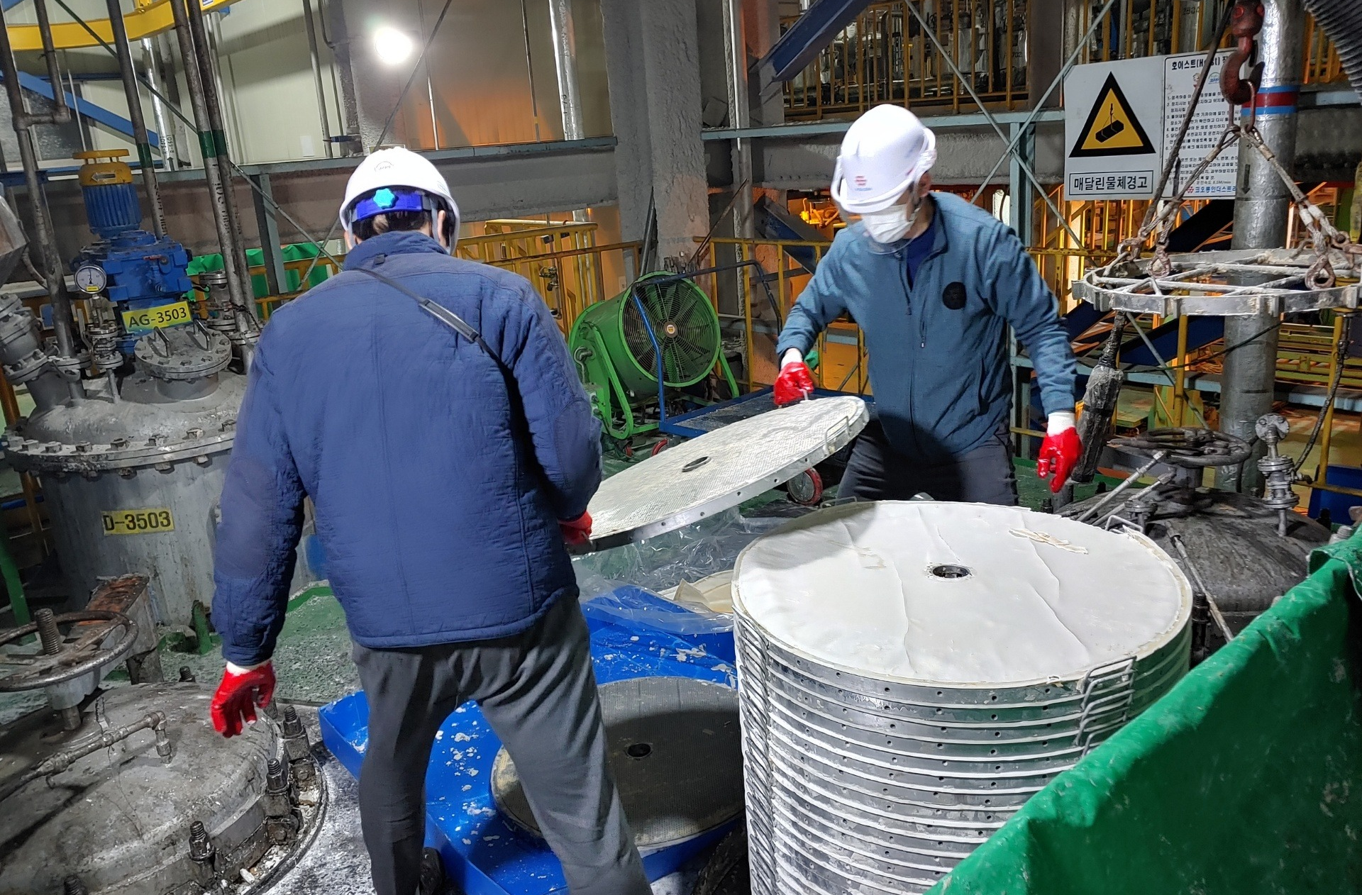
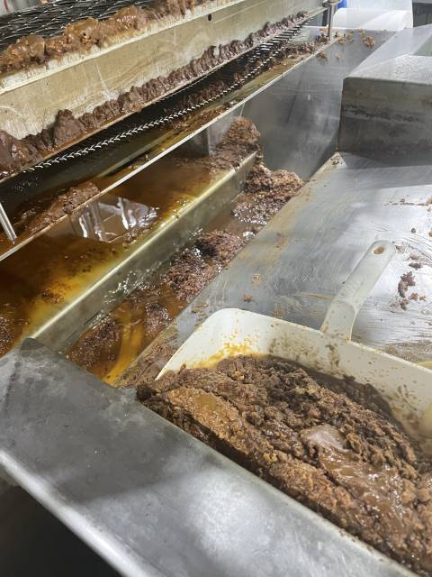
THE PROBLEM WITH CONVENTIONAL MANUAL FILTRATION
Manual disassembly, cleaning and waste handling can interrupt production.
Typical burdens
• Manual disassembly and reassembly
• Long cleaning work
• Production interruption
• Labor-intensive sludge handling
• Direct handling of hot oil/process residue
MANUAL FILTER PLATE HANDLING
FILTECH KOREA SYSTEM | DD AUTOMATIC LIQUID FILTRATION SYSTEM
2

Slide 3
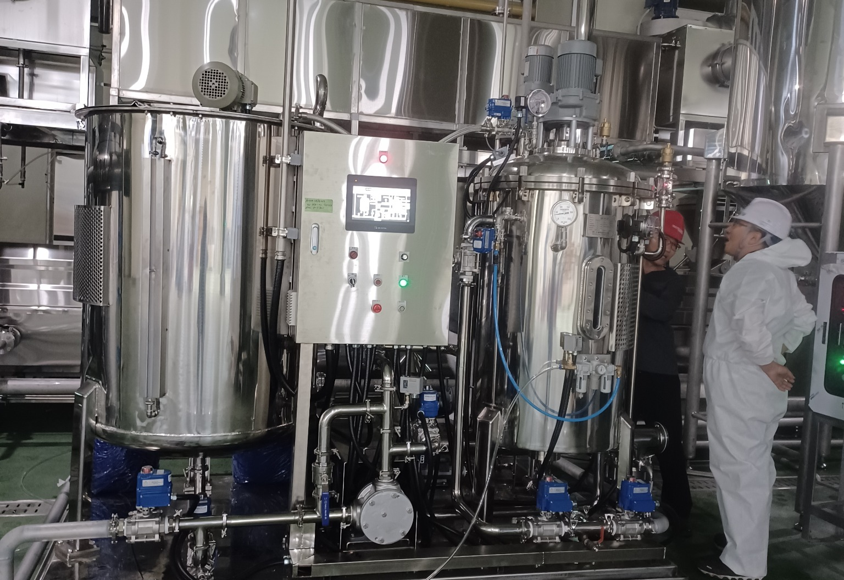
FROM MANUAL WORK TO FULL AUTOMATION
A compact filtration system designed for actual factory operation.
ONE TOUCH.
COMPLETE FILTRATION.
FULLY AUTOMATIC OPERATION
Automated filtration cycle with operator-initiated cleaning available.
AUTOMATIC SLUDGE DISCHARGE
Reduces manual filter-cake removal.
RAPID CLEANING
Approx. 5 minutes after oil draining.
COMPACT STAINLESS DESIGN
SUS304 standard; SUS316/316L available by process requirement.
FILTECH KOREA SYSTEM | DD AUTOMATIC LIQUID FILTRATION SYSTEM
3

Slide 4
AUTOMATIC OPERATION PROCESS
Pre-coating is selectable according to product and sludge characteristics.
1
→
2
→
3
→
4
→
5
LIQUID CHARGING
OPTIONAL PRE-COATING
FILTRATION
OIL DRAINING
CLEANING & READY
Process liquid enters the filtration system.
Adjustable pre-coating time when filter aid is required.
Normal filtration typically operates below 2 bar.
Approx. 5-7 min after filtration is completed.
Automatic cleaning approx. 5 min, then ready for the next cycle.
SMART CLEANING CONTROL
Cleaning can be initiated automatically based on operating conditions or manually by the operator at the end of production. Detailed control logic is kept as proprietary engineering know-how.
FILTECH KOREA SYSTEM | DD AUTOMATIC LIQUID FILTRATION SYSTEM
4

Slide 5
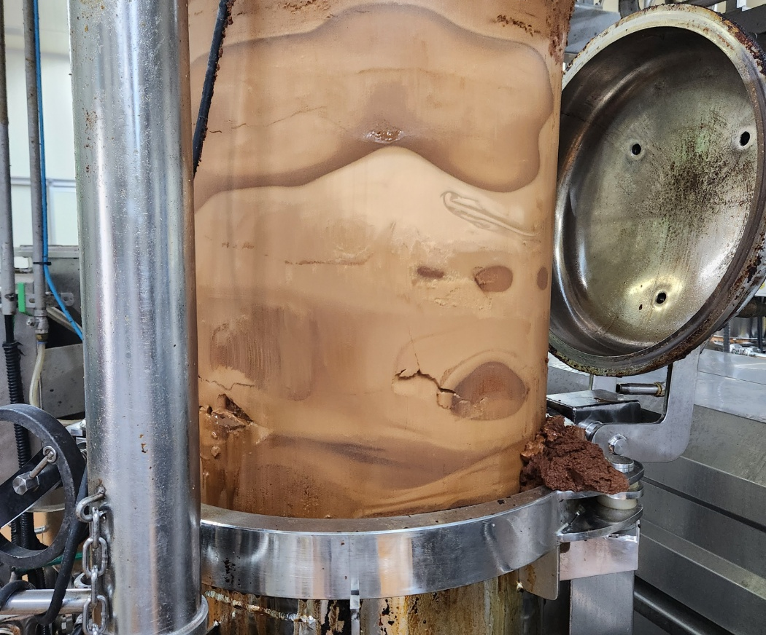
FILTRATION OPTIONS FOR DIFFERENT PROCESS CONDITIONS
Filter aid can be used or omitted depending on particle size, solids load and process requirements.
FINE-MESH DISC FILTRATION
VERY FINE + LOW SOLIDS
Filter aid may be required to establish an effective filtration layer.
FINE POWDER + HIGH SOLIDS
Many applications can operate without diatomaceous earth.
COARSE FOOD PARTICLES
Applications with coarse frying residues commonly operate without filter aid.
Actual case: sludge hardened inside a manual filter,
requiring more than 3 hours of hot-water soaking for removal.
Pre-coating time is adjustable to suit the process.
FILTECH KOREA SYSTEM | DD AUTOMATIC LIQUID FILTRATION SYSTEM
5

Slide 6
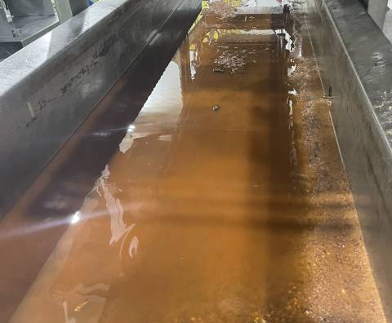
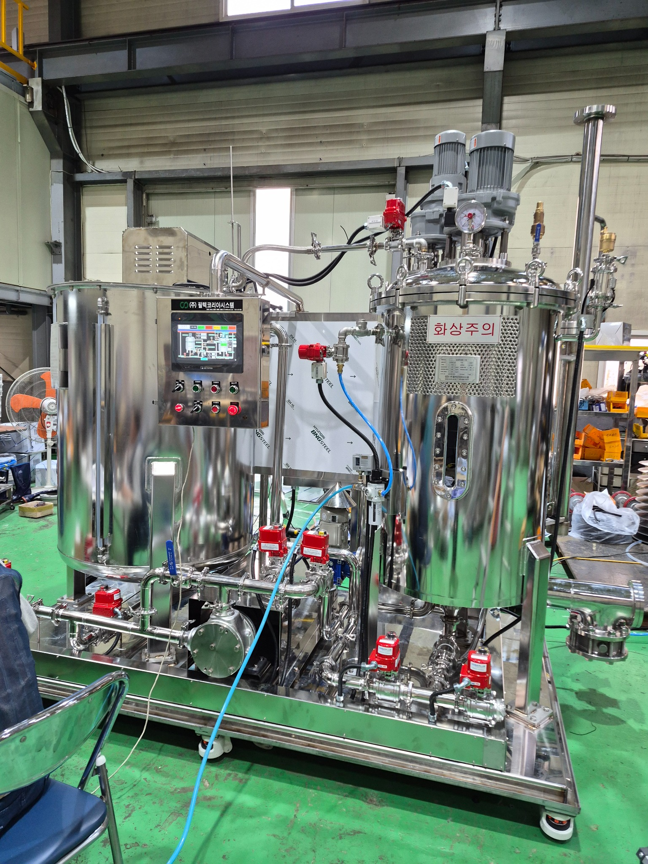
AUTOMATIC SLUDGE DISCHARGE
Less manual handling. Faster turnaround. Easier end-of-cycle cleaning.
END-OF-CYCLE SEQUENCE
OIL DRAINING | approx. 5-7 min
AUTOMATIC CLEANING | approx. 5 min
Actual food-factory
sludge
Reduced direct contact with hot oil and process residues.
FILTECH KOREA SYSTEM | DD AUTOMATIC LIQUID FILTRATION SYSTEM
6

Slide 7
WHY FILTECH?
Built for productivity and adaptable to real-world process conditions.
FULL AUTOMATION
FAST CLEANING
LOW OPERATING PRESSURE
Automated filtration and sludge discharge.
Approx. 5-minute cleaning after oil draining.
Normal filtration typically below 2 bar.
UP TO 190°C
MATERIAL OPTIONS
PROCESS FLEXIBILITY
Suitable for high-temperature edible-oil applications.
SUS304 standard; SUS316/316L for corrosive duties.
With or without filter aid, depending on the application.
NON-WOVEN FABRIC-FREE FILTRATION | Filtration based on stainless-steel filter discs
FILTECH KOREA SYSTEM | DD AUTOMATIC LIQUID FILTRATION SYSTEM
7

Slide 8
REPRESENTATIVE TECHNICAL SPECIFICATIONS
DD automatic liquid filtration system - Ø480 mm × 15-disc configuration.
Filter disc
Ø480 mm × 15 discs
Filtration type
Single-side disc filtration
Operating temperature
Up to 190°C
Normal filtration pressure
Typically below 2 bar
Material
SUS304 / optional SUS316, SUS316L
Sludge discharge
Automatic
Oil draining
Approx. 5-7 min
Cleaning after draining
Approx. 5 min
TYPICAL FILTRATION CAPACITY - EDIBLE OIL
MODULAR & PARALLEL CONFIGURATION
Multiple units can be operated in parallel for higher production capacity.
180-190°C: approx. 7-8 ton/h | 100-120°C: approx. 6-7 ton/h | Room-temperature sesame oil: approx. 3 ton/h
Actual capacity varies with liquid type, temperature, viscosity, solids content and operating conditions. Lower-viscosity process liquids such as soy sauce and various chemical liquids may achieve higher throughput.
FILTECH KOREA SYSTEM | DD AUTOMATIC LIQUID FILTRATION SYSTEM
8

Slide 9
CUSTOM FILTRATION SOLUTIONS
FOR YOUR PROCESS
Edible Oil • Food Processing • Soy Sauce • Chemical Process Liquids • Electronics • Precision Materials • Pharmaceutical
ENGINEERED IN KOREA
Stainless-steel construction
Process-specific material selection
Flexible filter-aid operation
Automatic sludge discharge
High-temperature filtration capability
FILTECH KOREA SYSTEM
Contact details can be inserted after final confirmation.

